Slide 1
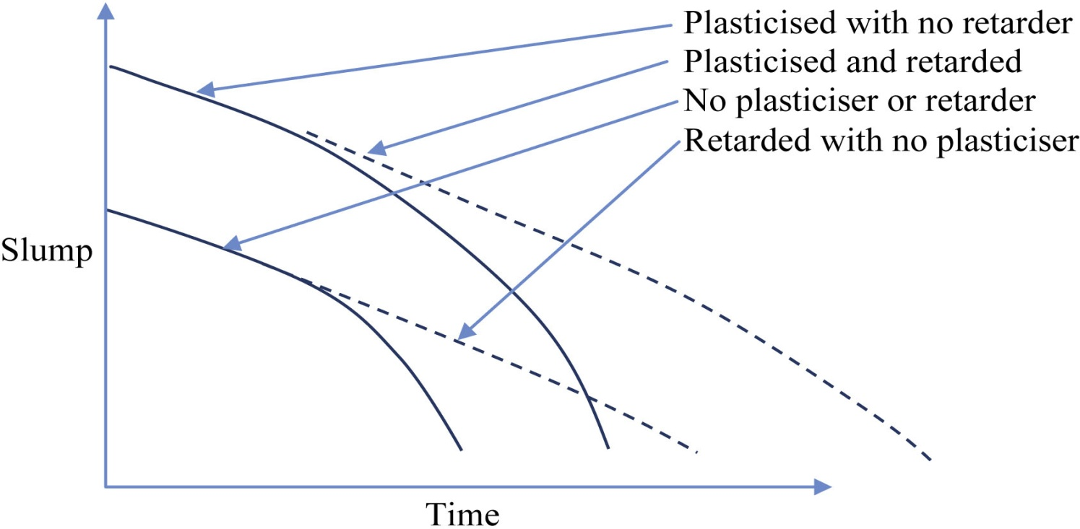
FIGURE 24.1 Schematic Graph of the Effect of Retarders
Copyright © 2016 Elsevier Ltd. All rights reserved.

